Slide 1
Customer Analytics RFM
Lecture 2

Slide 2
Agenda
RFM scores
RFM segments
Making rollout decisions based on RFM
Extensions

Slide 3
What is RFM?
Recency
When was the last time (relative to some date) that a customer purchased?
Frequency
How often did the customer purchase?
Monetary value
Total cumulative amount spent since first purchase
or
Average amount spent per order
RFM is a 3-number summary of customer behavior

Slide 4
Why RFM
Targeting all customers in database is too costly
Some customers will never respond or purchase
Use a model to select good customers who will respond/buy
Goal: predict the response or purchase probability of each customer
Use these predictions to target only, for example 20%, of customers rather than all

Slide 5
Example 1: Transaction-level dataset (CDNow)
Customer ID | Date (yyyymmdd) | Amount
1 | 19970101 | 29.33
1 | 19970118 | 29.73
1 | 19970802 | 14.96
1 | 19971212 | 26.48
2 | 19970101 | 63.34
2 | 19970113 | 11.77
3 | 19970101 | 6.79
4 | 19970101 | 13.97
5 | 19970101 | 23.94
6 | 19970101 | 35.99
6 | 19970111 | 32.99
6 | 19970315 | 77.96
6 | 19970416 | 59.3
6 | 19970424 | 134.98
6 | 19970623 | 91.92
6 | 19970722 | 47.08
6 | 19970726 | 71.96
6 | 19971025 | 78.47
6 | 19971206 | 83.47
6 | 19980118 | 84.46
6 | 19980215 | 123.96
6 | 19980221 | 32.98
6 | 19980226 | 23.06
6 | 19980510 | 72.99
6 | 19980620 | 55.47
Each row represents a transaction
Dates: 19970101 – 19980630
Analysis time is 19980701 (July 1, 1998)

Slide 6
Example 1: Transaction-level dataset
Customer ID | Date (yyyymmdd) | Amount
1 | 19970101 | 29.33
1 | 19970118 | 29.73
1 | 19970802 | 14.96
1 | 19971212 | 26.48
Timeline for customer 1
19970101
19971212
19980701
x
x
x
x
time
R = time between last transaction
and end of database
= 201 days
= 28.7 weeks
= 7.2 months
The units are not that important
F = # of transactions = 4
M = total amount / # of transactions = 25.13
or
M = total amount = 100.50

Slide 7
Transaction-level dataset
Customer ID | Date (yyyymmdd) | Amount
1 | 19970101 | 29.33
1 | 19970118 | 29.73
1 | 19970802 | 14.96
1 | 19971212 | 26.48
2 | 19970101 | 63.34
2 | 19970113 | 11.77
3 | 19970101 | 6.79
4 | 19970101 | 13.97
5 | 19970101 | 23.94
6 | 19970101 | 35.99
6 | 19970111 | 32.99
6 | 19970315 | 77.96
6 | 19970416 | 59.3
6 | 19970424 | 134.98
6 | 19970623 | 91.92
6 | 19970722 | 47.08
6 | 19970726 | 71.96
6 | 19971025 | 78.47
6 | 19971206 | 83.47
6 | 19980118 | 84.46
6 | 19980215 | 123.96
6 | 19980221 | 32.98
6 | 19980226 | 23.06
6 | 19980510 | 72.99
6 | 19980620 | 55.47
Customer-level dataset
ID | R (days) | F | M (average)
1 | 201 | 4 | 25.13
2 | 533 | 2 | 37.56
3 | 545 | 1 | 6.79
4 | 545 | 1 | 13.97
5 | 545 | 1 | 23.94
6 | 10 | 16 | 69.19
Each row represents a customer
Each row represents a transaction

Slide 8
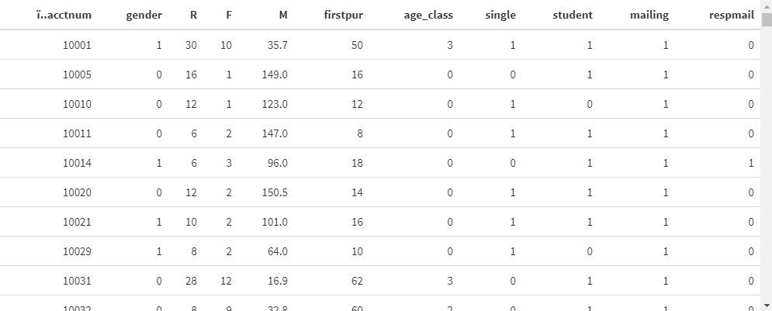
Example 2: customer-level data set (ebeer)
Notes:
R is in months, M is average

Slide 9
RFM for segment-level prediction
Rather than use the raw customer-level RFM scores, marketers typically group them into segments based on ranking and sorting them.
First we’ll do this to one variable, recency.
Then we’ll do the full analysis.

Slide 10
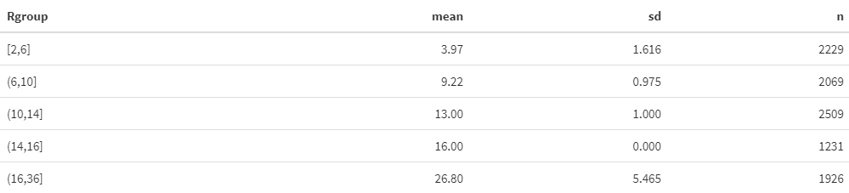
First let’s look (separately) at R
We can rank customers individually on R by creating groups:
Group 1: top 20% most recent customers
Group 2: 2nd most 20% recent customers
..
Group 5: bottom 20% recent customers
Notes:
The 20% most recent 4 months ago on average

Slide 11
How does the response probability change across segments?

Slide 12
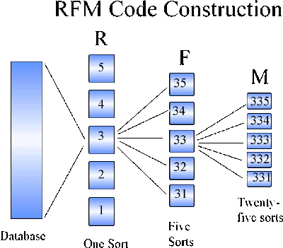
Full RFM segmentation
Sort by R, create 5 groups (we just did this!)
For each R group (5), sort by F & create 5 groups
For each RF group (25), sort by M & create 5 groups
You can also do this with different numbers of groups per var (e.g., 3) or independently rather than nested.
Quick Profits with RFM Analysis

Slide 13
125 total possible combinations
In this specific case (ebeer) only 90 segments, because of bunching. Some groups may have only 4 possible values of frequency, so it makes no sense to create 5 groups.
Also unequal numbers in groups due to bunching.
But discrete distribution means unequal cells.

Slide 14

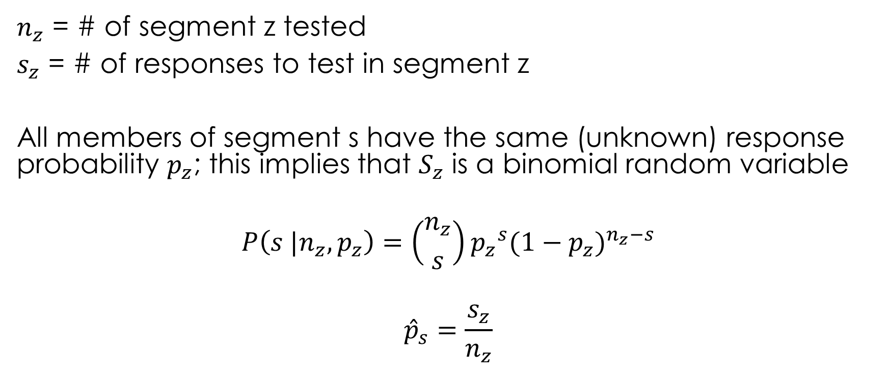
For each RFM segment, estimate response rate
$n_{z}$ = # of segment z tested
$s_{z}$ = # of responses to test in segment z
All members of segment s have the same (unknown) response probability $p_{z}$; this implies that $S_{z}$ is a binomial random variable
$$P\left(s |n_{z},p_{z}\right)=\left({n_{z} \atop s}\right){p_{z}}^{s}{({1−p}_{z})}^{n_{z}−s}$$
$${\hat{p}}_{s}=\frac{s_{z}}{n_{z}}$$
$$se\left({\hat{p}}_{z}\right)=\sqrt{\frac{{\hat{p}}_{z}\left(1−{\hat{p}}_{z}\right)}{n_{z}}}$$

Slide 15
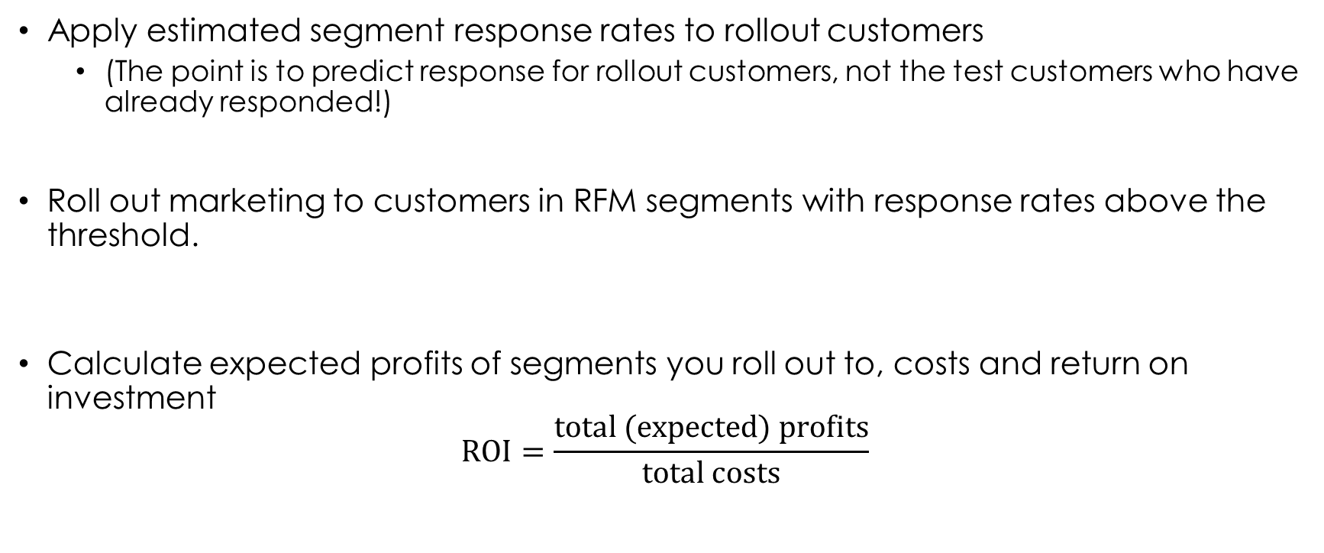
Using the results: next steps
Apply estimated segment response rates to rollout customers
(The point is to predict response for rollout customers, not the test customers who have already responded!)
Roll out marketing to customers in RFM segments with response rates above the threshold.
Calculate expected profits of segments you roll out to, costs and return on investment
$$\text{ROI}=\frac{\text{total}\text{ (}\text{expected}\text{) }\text{profits}}{\text{total} \text{costs}}$$

Slide 16
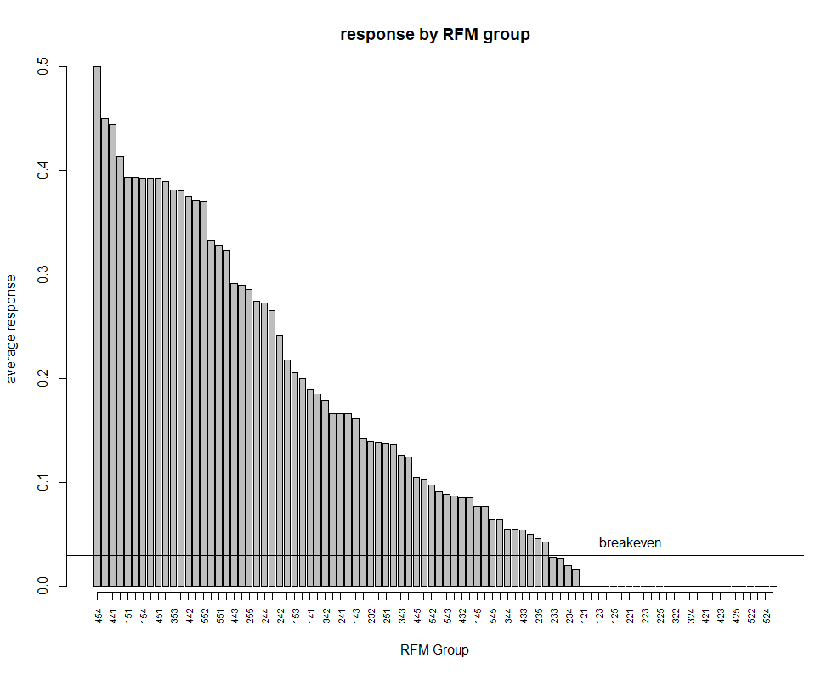


60 out of 90 RFM segments targeted
If ${\hat{p}}_{z}>p_{BE}$, target all customers in segment z
$$p_{BE}=\frac{c}{m}=\frac{1.50}{50}=0.03$$

Slide 17
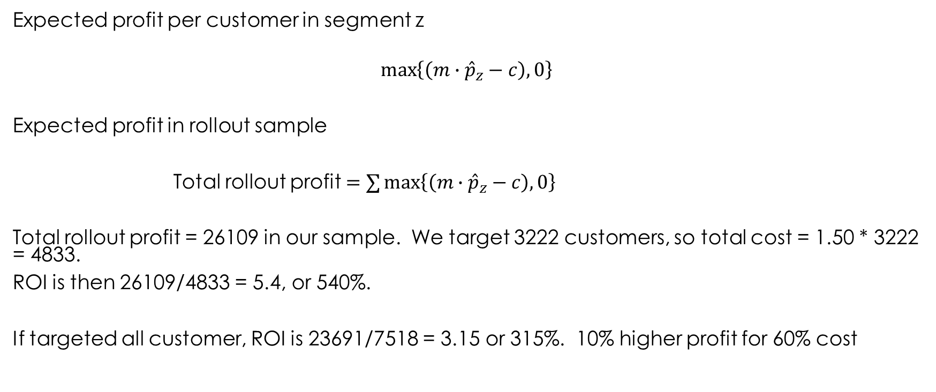
Expected profits and ROI
Expected profit per customer in segment z
$$\max\left\{\left(m∙{\hat{p}}_{z}−c\right),0\right\}$$
Expected profit in rollout sample
Total rollout profit $=∑\max\left\{\left(m∙{\hat{p}}_{z}−c\right),0\right\}$
Total rollout profit = 26109 in our sample. We target 3222 customers, so total cost = 1.50 * 3222 = 4833.
ROI is then 26109/4833 = 5.4, or 540%.
If targeted all customer, ROI is 23691/7518 = 3.15 or 315%. 10% higher profit for 60% cost

Slide 18
Advantages of RFM
Easy to understand, easy to compute and easy to give managerial recommendations
Target RFM segments in rollout sample above breakeven response probabilities
One of the oldest customer metrics still popular today (and for a reason!)

Slide 19
Advantages of RFM
Common types of data used in marketing models
Transaction data: past purchases, amounts, dates, discounts, …
Demographics: gender, ethnicity, age, income, family size, occupation, marital status, education, homeowner or renter, length of residence (typically available for prospects)
Marketing: past mailings, content mailings, date, costs
(Survey data, e.g. Psychographics): attitudes, interests, activities
Readily available
See BKN chapter 8
Notes:
Of course not for prospects!

Slide 20
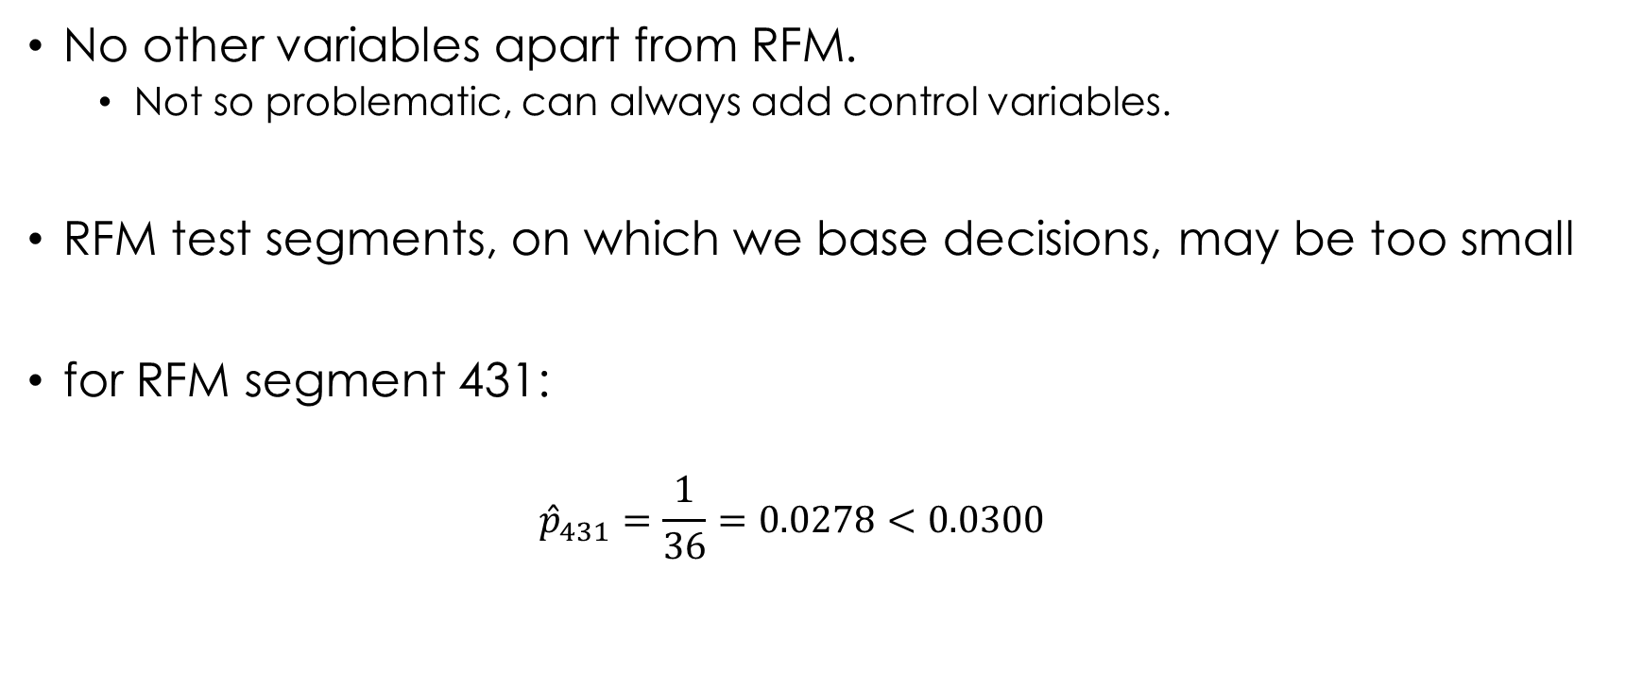
Problems with RFM
No other variables apart from RFM.
Not so problematic, can always add control variables.
RFM test segments, on which we base decisions, may be too small
for RFM segment 431:
$${\hat{p}}_{431}=\frac{1}{36}=0.0278<0.0300$$
RFMgroup n_resp n_nonresp n_mail resp_rate
431 1 35 36 0.0278
$$se\left({\hat{p}}_{431}\right)=0.0274$$

Slide 21
Can repeat analysis with fewer RFM categories than 5
2 x 2 x 2 RFM or 3 x 3 x 3 RFM
Lower variance, higher bias

Slide 22
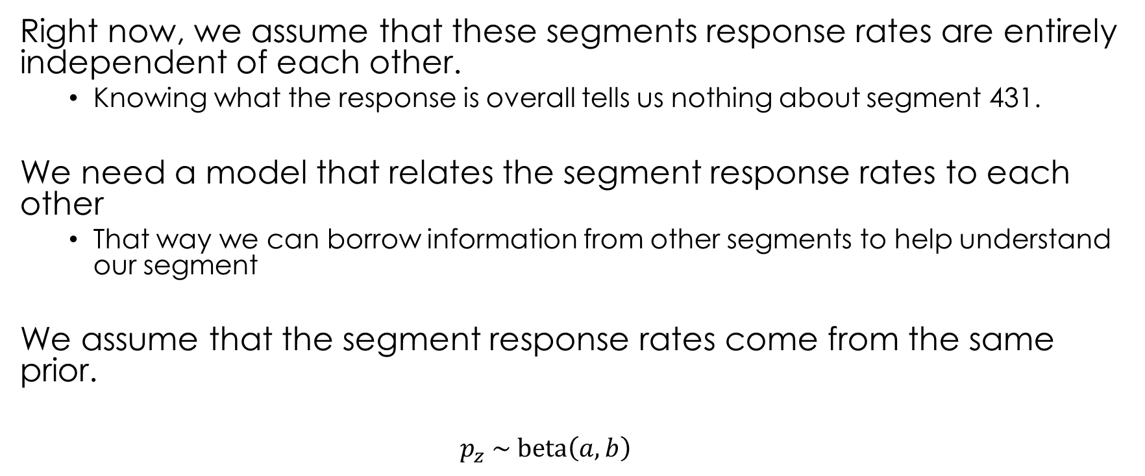
Extension 1: Bayesian approach
Right now, we assume that these segments response rates are entirely independent of each other.
Knowing what the response is overall tells us nothing about segment 431.
We need a model that relates the segment response rates to each other
That way we can borrow information from other segments to help understand our segment
We assume that the segment response rates come from the same prior.
$$p_{z} \sim \text{beta}\left(a,b\right)$$

Slide 23
Empirical Bayes
In lecture 1, we talked about the prior as something that you think about before seeing the data.
Previous experience: past campaigns’ response rates range from about 0-10%, on average slightly below 3%
Or truly no idea: every value is equally likely (flat or diffuse prior)
But in this case, we have many parallel potentially similar groups (segments). We can use them to see what the prior distribution looks like (in order to pick parameters a and b). We can choose the prior distribution to look most like the actual distribution, across segments.
Using data to estimate the prior distribution (rather than in L1, just assuming some form) is called Empirical Bayes.
happens a lot with Big Data!

Slide 24

Distribution of segment specific response rates
$$\text{beta}(a=0.3,b=3.0)$$
Notes:
I guessed these numbers;

Slide 25
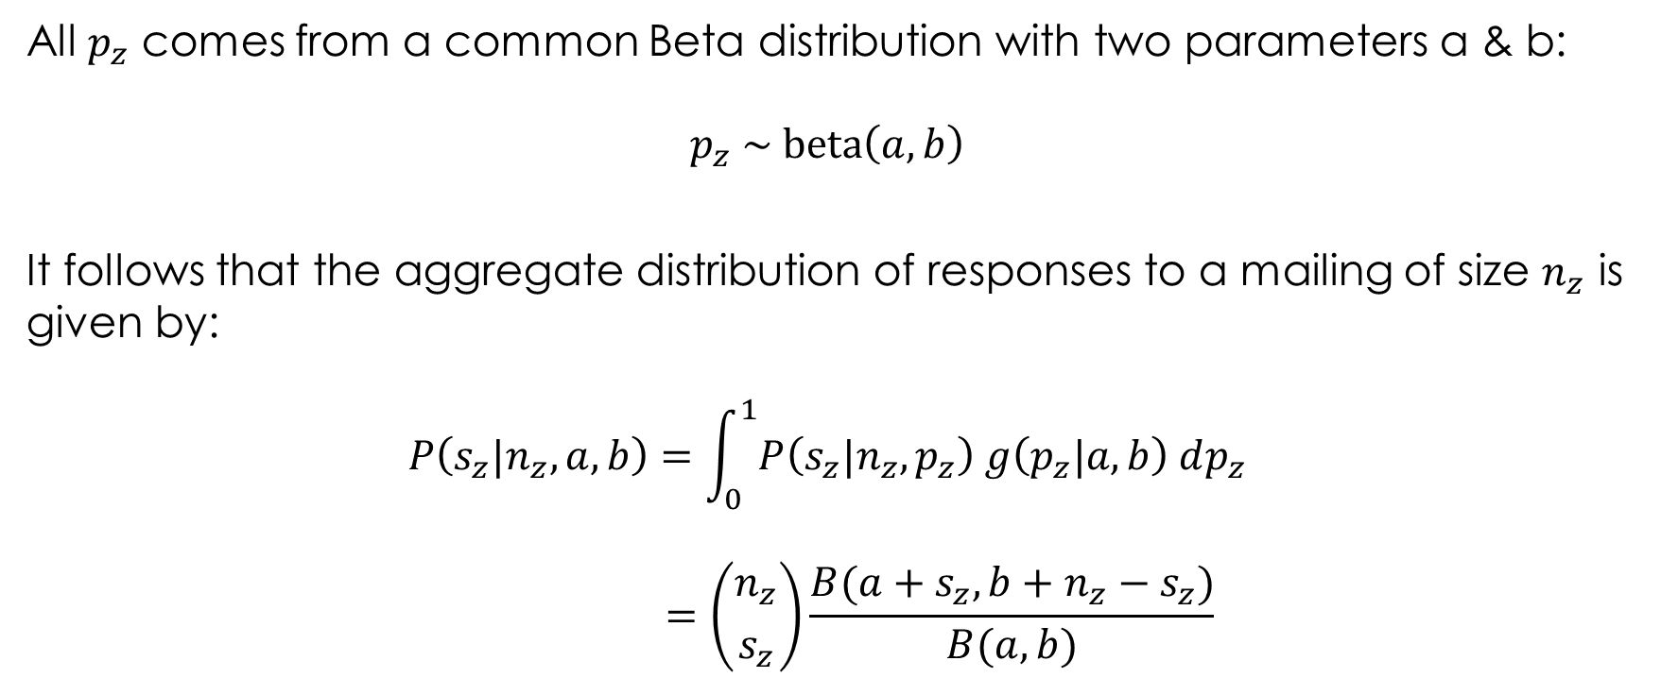
Extension 1: Beta-binomial model
All $p_{z}$ comes from a common Beta distribution with two parameters a & b:
$$p_{z} \sim \text{beta}\left(a,b\right)$$
It follows that the aggregate distribution of responses to a mailing of size $n_{z}$ is given by:
$$P\left(s_{z}|n_{z},a,b\right)=\int_{0}^{1}{P\left(s_{z}|n_{z},p_{z}\right) g\left(p_{z}|a,b\right) dp_{z}}$$
$$=\left({n_{z} \atop s_{z}}\right)\frac{B(a+s_{z},b+n_{z}−s_{z})}{B(a,b)}$$

Slide 26

Estimation
Estimate the model: find $a \& b$ that maximize log-likelihood
$$LL\left(a,b | s_{z},n_{z}\right)=\sum_{z}{\ln\left(P\left(s_{z}|n_{z},a,b\right)\right)}$$

Slide 27

$$\text{beta}(\hat{a}=0.493,\hat{b}=3.113)$$

Slide 28
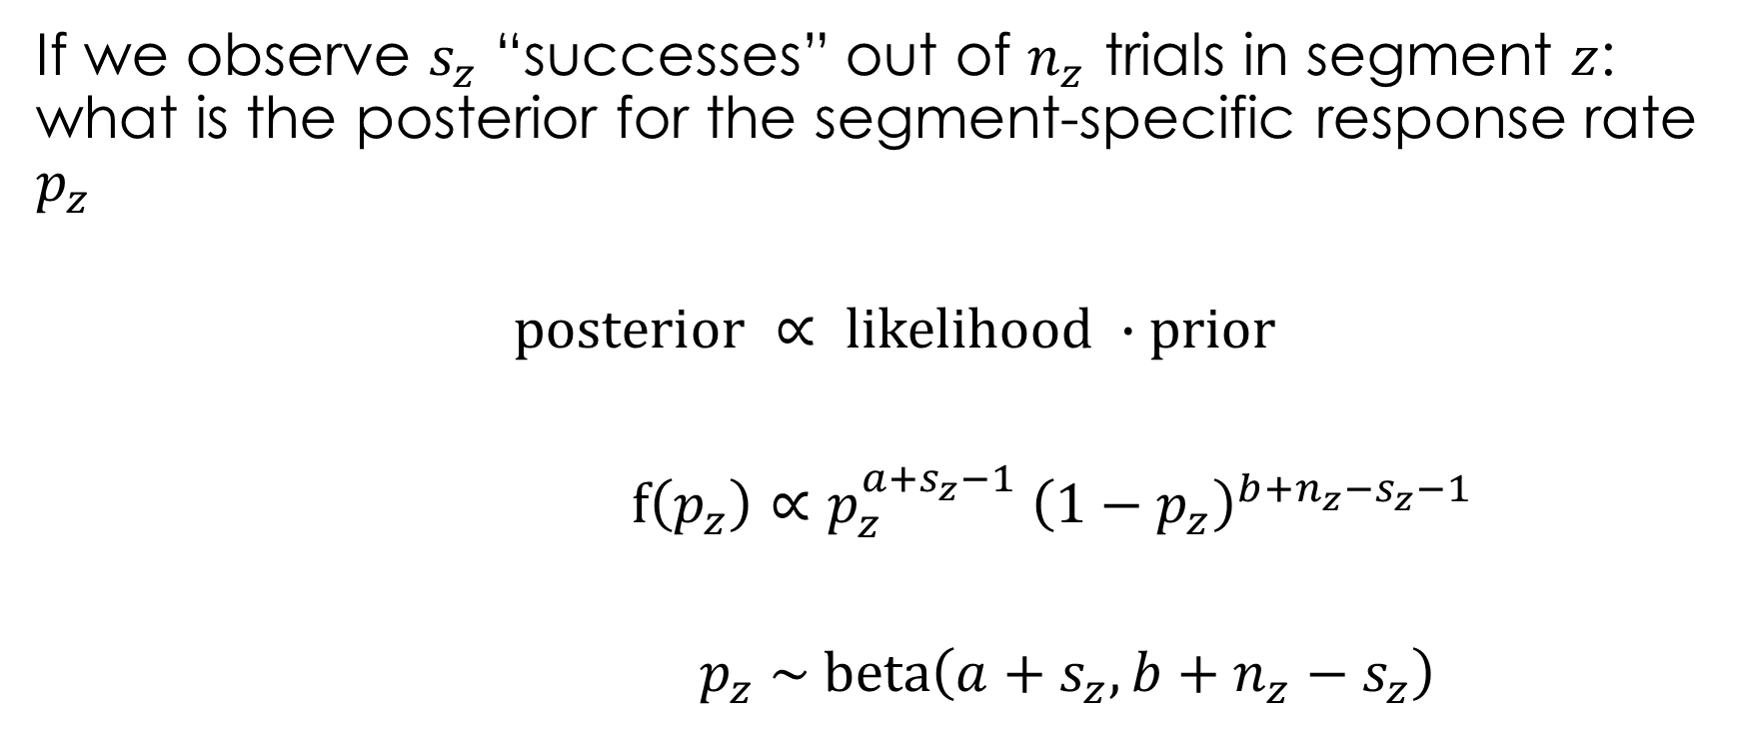
Bayes rule
If we observe $s_{z}$ “successes” out of $n_{z}$ trials in segment $z$: what is the posterior for the segment-specific response rate $p_{z}$
$$\text{posterior} ∝ \text{likelihood} ∙\text{prior}$$
$f\left(p_{z}\right)∝p_{z}^{a+s_{z}−1} {\left(1−p_{z}\right)}^{b+n_{z}−s_{z}−1}$
$p_{z} \sim \text{beta}\left(a+s_{z}, b+n_{z}−s_{z}\right)$

Slide 29

Posterior mean segment response rate
For $p \sim \text{beta}\left(a,b\right)$,
$E\left[p\right]=\frac{a}{a+b}$.
Applying this to our case, $p_{z} \sim \text{beta}\left(a+s_{z}, b+n_{z}−s_{z}\right)$
$$E\left[p_{z}\right]=\frac{a+s_{z}}{a+b+n_{z}}$$
12.8 in BKN

Slide 30
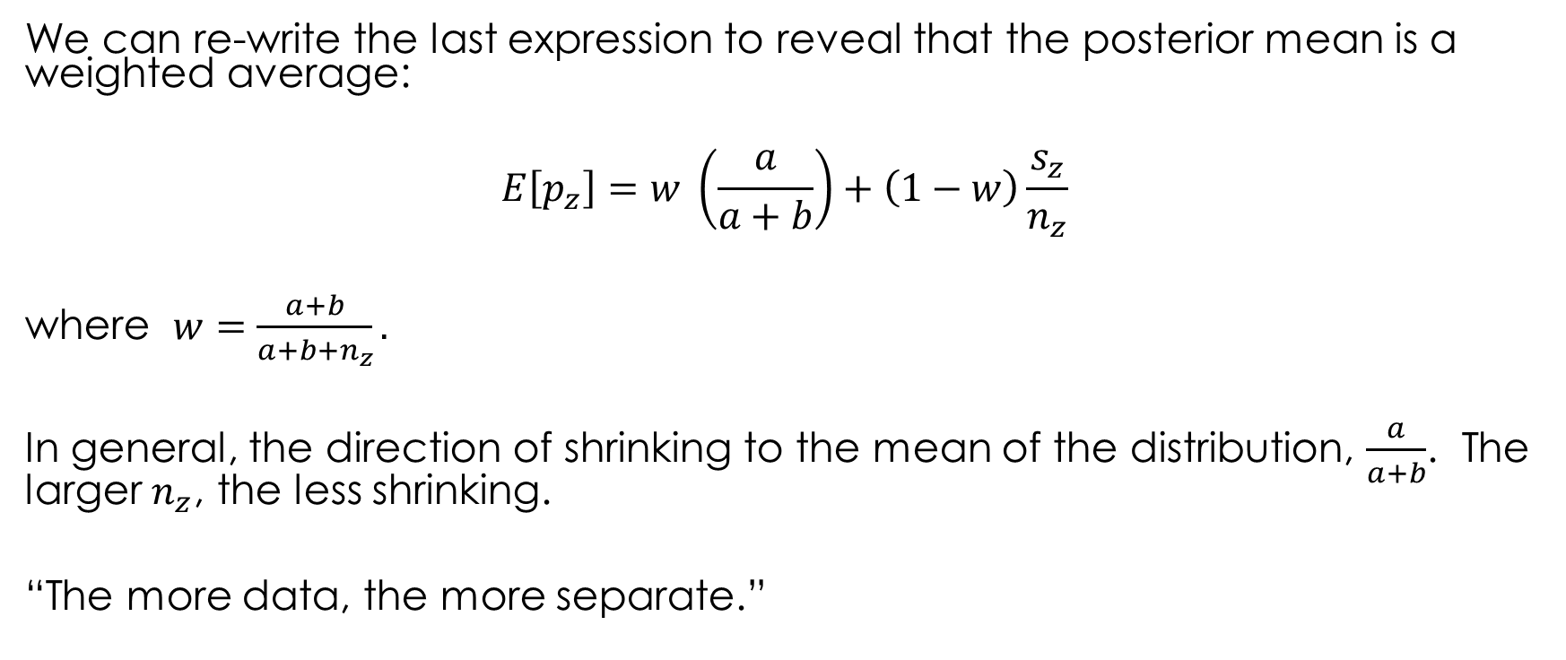
Bayes as compromise
We can re-write the last expression to reveal that the posterior mean is a weighted average:
$$E\left[p_{z}\right]=w \left(\frac{a}{a+b}\right)+\left(1−w\right)\frac{s_{z}}{n_{z}}$$
where $w=\frac{a+b}{a+b+n_{z}}.$
In general, the direction of shrinking to the mean of the distribution, $\frac{a}{a+b}$. The larger $n_{z}$, the less shrinking.
“The more data, the more separate.”

Slide 31
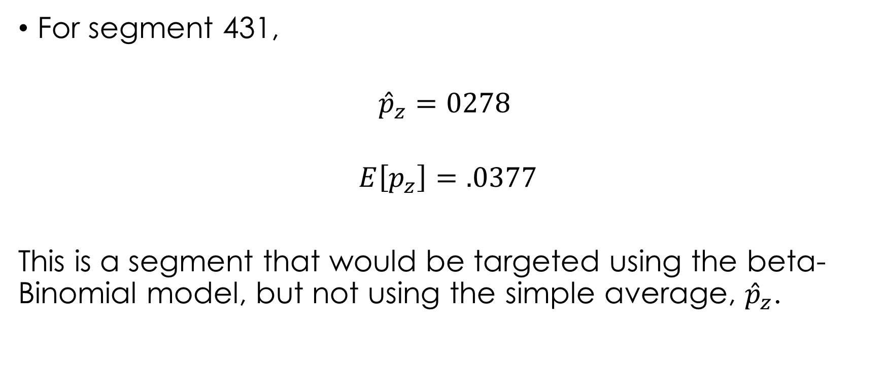
Shrinking estimates
For segment 431,
$${\hat{p}}_{z}=0278$$
$$E\left[p_{z}\right]=.0377$$
This is a segment that would be targeted using the beta-Binomial model, but not using the simple average, ${\hat{p}}_{z}$.

Slide 33
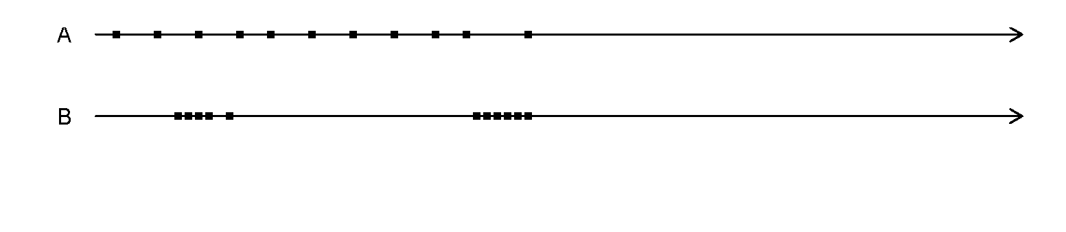
Extension 2: Clumpiness
Both of these customers have the same values of R and F
From data perspective, the user is called clumpy when more or larger clumps of visits are observed.
Clumps of visits indicate non-constant visiting rate, specially temporary elevations of propensity --- i.e., periods during which the user is more likely to visit/purchase than his/her average level.
Are Your Customers Clumpy? What Binge-Buying Means for Marketers

Slide 34
Conclusion
RFM perhaps oldest example of customer analytics
Still used, because easy-to-compute, understand, and guide targeting decisions
Drawbacks: small sample size, no other variables included

